Slide 1
Data Structures & Algorithm
Instructor: Rida Zahra
Department of computer science

Slide 2
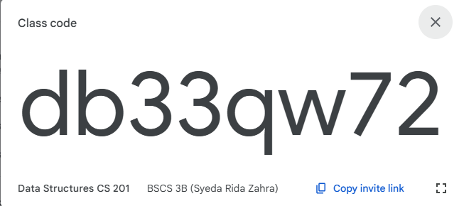
Google Classroom Codes
Theory Code

Slide 3
Evaluation Criteria
Assessment | %Age
Assignments/ Quizzes | 7.5% + 11.25% = 18.75%
Viva/Sessional | 10% + 15% = 25%
Mid Term Exam | 22.5%
Final Term Exam | 33.75%
Total | 100

Slide 4
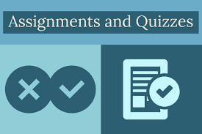
Quizzes
Assignments
Assignments will be due at the beginning of the class. Under normal circumstances, late work will not be accepted.
Students are expected to do their own assignments.
Plagiarism will be observed strictly.
Surprise/ Announced quizzes to assess the understanding of taught topics.

Slide 5

How to perform well?
Revise the topic covered in class the same day.
Complete the tasks given, you might get bonus points for that. ☺
Feel free to consult me during my office hours.

Slide 6

Few Things to Remember
Show sensibility in your conduct.
Learning should be your primary objective.
Attendance will be marked within 15 minutes at the start of the class.
80% of your attendance is mandatory.
Zero tolerance policy on attendance, discipline in class during lectures.
Assignments must be submitted on time, no late submissions.
In case of copied assignment both parties will be given zero.
Don’t miss your Classes, Quizzes, Presentations, Assignments and Projects/Presentations.
You all need to be a good human being.

Slide 7
Course Objectives
To understand the design of fundamental data structures as well as algorithms that operate on them
To understand the fundamental tradeoffs in the design of the data structures
To introduce tools for analyzing the time and space complexity of data structures

Slide 8
Course Learning Outcomes
After successful completion of this course, the students should be able to: | GA |  | BT Level
1. Explain the fundamentals of data structure as well as algorithms that operate on them | 2 |  | C2
2. Apply and design various data structures methods for specified applications. | 4 |  | C3
3. Analyze empirically the behavior of algorithms in terms of time andmemory used | 3 |  | C4

Slide 9
Mapping of CLO’s to GA’s
GA’s/CLOs | CLO1 | CLO2 | CLO3
GA1 (Academic Education)
GA2 (Knowledge for Solving Computing Problems) | ✔
GA3 (Problem Analysis) |  |  | ✔
GA4 (Design/Development of Solutions) |  | ✔
GA5 (Modern Tool Usage)
GA6 (Individual and Teamwork)
GA7 (Communication)
GA8 (Computing Professionalism and Society)
GA9 (Ethics)
GA10 (Life-long Learning)

Slide 10
Text and Reference Books
Text Books:
Data Structures and Algorithms in C++ by Michael T. Goodrich, Roberto Tamassia, and David Mount (2nd Edition)
Data Structures and Algorithm Analysis in C++ by Mark Allen Weiss (4th Edition)
Reference Books
Malik, D S. Data Structures in C++, 2nd Edition, Cengage Learning

Slide 11
Course Overview
Introduction to data structures.
Analysis tools.
Arrays.
Linked list.
Stacks.
Queues.
Trees.
Binary search tree.
Hash tables.
Sorting.
Graphs

Slide 12
Prerequisites
This module assumes that you understand the fundamentals of Programming
Variables, statements, functions, loops, etc.
Note: Basic structure of C++ will be used in this subject.

Slide 13

Programming Basics

Slide 14
Today’s Goal
To review basic programming concepts like:
Variables and constants.
Data types.
Operators.
Control flow.

Slide 15
Variable and Constant
In a program, data values can be constant or variable.
If values are variable they can be changed by the program and the user.
When a program is running, the data values are held in memory while they are being worked on.

Slide 16
Constant
Constants are values which cannot be modified e.g. the value of Pi
To declare a constant in Java, we write a keyword “final” before the variable type.
final double pi = 3.14;

Slide 17
Variable
To store a value inside a computer a ‘variable’ is used.
A variable is a space in the memory to store a value.
This space is reserved until the variable is required.

Slide 18
What Makes a Variable?
Variable has three important characteristics:
Type
How much memory do a variable need.
This information is determined by a type.
Name
How to differentiate a variable with another variable of the same type.
Name refers to the memory location assigned to this variable.
Value
What is the value?
The actual value contained by a variable.

Slide 19
An Example of a Variable
Type of the variable is integer (written as “int” in Java)
int
35
=
temperature
A name of the variable
An initial value of the variable

Slide 20
Rules for naming a variable
Following are the rules for naming variables:
Variable names in C++ can range from 1 to 255 characters.
All variable names must begin with a letter of the alphabet or an underscore(_).
After the first initial letter, variable names can also contain letters and numbers.
Variable names are case sensitive.
No spaces or special characters are allowed.
You cannot use a C++ keyword (a reserved word) as a variable name.

Slide 21
Some Examples
Here are some examples of acceptable variable names:
Mohd, Ali, abc, move_name, a_123, myname50, _temp, j, a23b9, retVal

Slide 22
Type of a Variable-Data type
Computer programs use data types to organize different types of data in a program.
Among other advantages a ‘type’ binds the memory to a variable name.
Following data types exist:
Int
Float
Double
Char
Boolean

Slide 23
Int
The type int is of 4 bytes (8x4= 32 bits).
Therefore, it can hold maximum of 2,147,483,647 value.
It can also hold values in negative down to
-2,147,483,648.

Slide 24
Data type for real numbers-float
int cannot hold a real value.
Therefore, the type “float” and “double” are used to hold real values.
A variable of type float holds floating type data or real numbers, e.g., -11.4, 3.1416.
Float occupies 4 bytes in memory.
It can store values in range 3.4 x10^-38 to 3.4x10^38

Slide 25
Data type for real numbers-double
Double takes 8 bytes (8x8=64 bits) of memory instead of 4 bytes of an int.
Out of the 8 bytes in a double 4 bytes are used to hold the value before the decimal point and 4 bytes for the value after the decimal point.

Slide 26
Relative Comparison of int and double
int numPeople = 2;
Reserves 32 bits (4 bytes)
and sets the value stored
in that space to 2. The name
‘numPeople’ is associated with
this space.
double bill = 32.45;
Reserves 64 bits (8 bytes)
and sets the value stored
in that space to 32.45. The name
‘bill’ is associated with
this space.

Slide 27
Char Data Type
A variable of type char holds only a single lower case letter, a single uppercase letter, a single digit or a single special character (e.g., $ or *).
char takes only 1 byte (8 bits) in memory.
It can store values from -128 to 127.
Collection of characters=> string

Slide 28
Boolean Data Type
Java has a simple type, called boolean, for logical values.
It can have only one of two possible values, true or false.
This is the type returned by all relational operators, suchas a < b.
boolean is also the type required by the conditional expressions that govern the control statements such as if and for.

Slide 29
Variable declarations
Variable in a computer program is declared as:
datatype variable_name;
For example: int var;
float var;
Variables can also be assigned values as:
datatype variable_name= value;
For example: int var=8;
float var=4.5;
double var=23.4556;
char var=‘a’;
string str1 = "Hello";

Slide 30
Operators used in Computer Programming
Assignment
A binary operator ‘=’:
variable = expression;
e.g. x=x+1
Arithmetic
Used to compute arithmetic expressions e.g. ‘+’, ‘-’, ‘*’, ‘/’, ‘%’.

Slide 31
Increment/ Decrement Operators
Two unary operators:
1) ++ increments its operand by 1
2) -- decrements its operand by 1
The operand must be a numerical variable.
Each operation can appear in two versions:
• prefix version evaluates the value of the operand after
performing the increment/decrement operation
• postfix version evaluates the value of the operand before
performing the increment/decrement operation

Slide 32
Relational Operator
Relational operators determine the relationship that one operand has to the other operand, specifically equality and ordering.
The outcome is always a value of type boolean.
They are most often used in branching and loop control statements.
e.g. ‘==’, ‘!=’, ‘>’, ‘<’, ‘>=’, ‘<=’

Slide 33
Logical Operators
Logical operators act upon boolean operands only.
The outcome is always a value of type boolean.
E.g. AND(&), OR(|), NOT(!), XOR(^).

Slide 34

Control Flow
Writing a program means typing statements into a file.
Without control flow, the interpreter would execute these statements in the order they appear in the file, left-to-right, top-down.
Control flow statements, when inserted into the text of the program, determine in which order the program should be executed.

Slide 35
Types of control flow statements
Selection statements
if
if-else
if-else-if
switch
Iteration Statements
While
Do-while
For
Jump Statements
break
return
continue

Slide 36
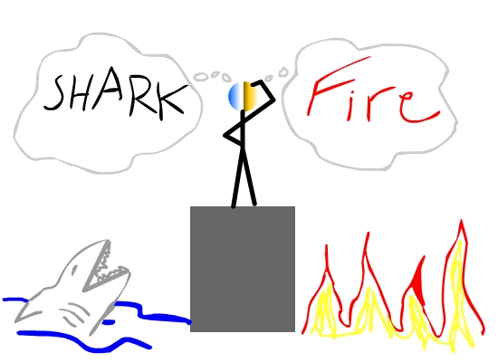
Simple/Compound if statements
The component statement may be:
simple
if (expression) statement;
compound
if (expression) {
statement;
}

Slide 37
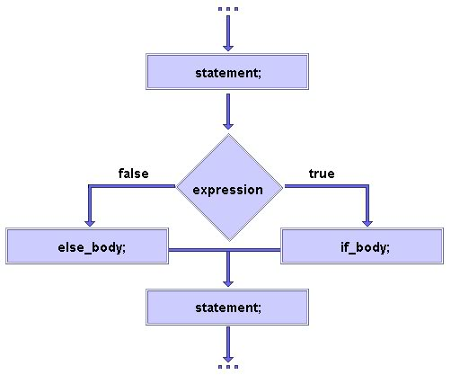
If-else statement
Suppose you want to perform two different statements depending on the outcome of a boolean expression. if-else statement can be used.
General form:
if (expression) statement1
else statement2
Again, statement1 and
statement2 may be simple
or compound.

Slide 38
If-else-if statement
General form:
if (expression1)
statement1
else if (expression2)
statement2
else if (expression3)
statement3
…
else statement

Slide 39
Example
Write a program that inputs test score of a student and displays his grade according to the following criteria
Test Score Grade
>=90 A
80-89 B
70-79 C
60-69 D
Below 60 F

Slide 40
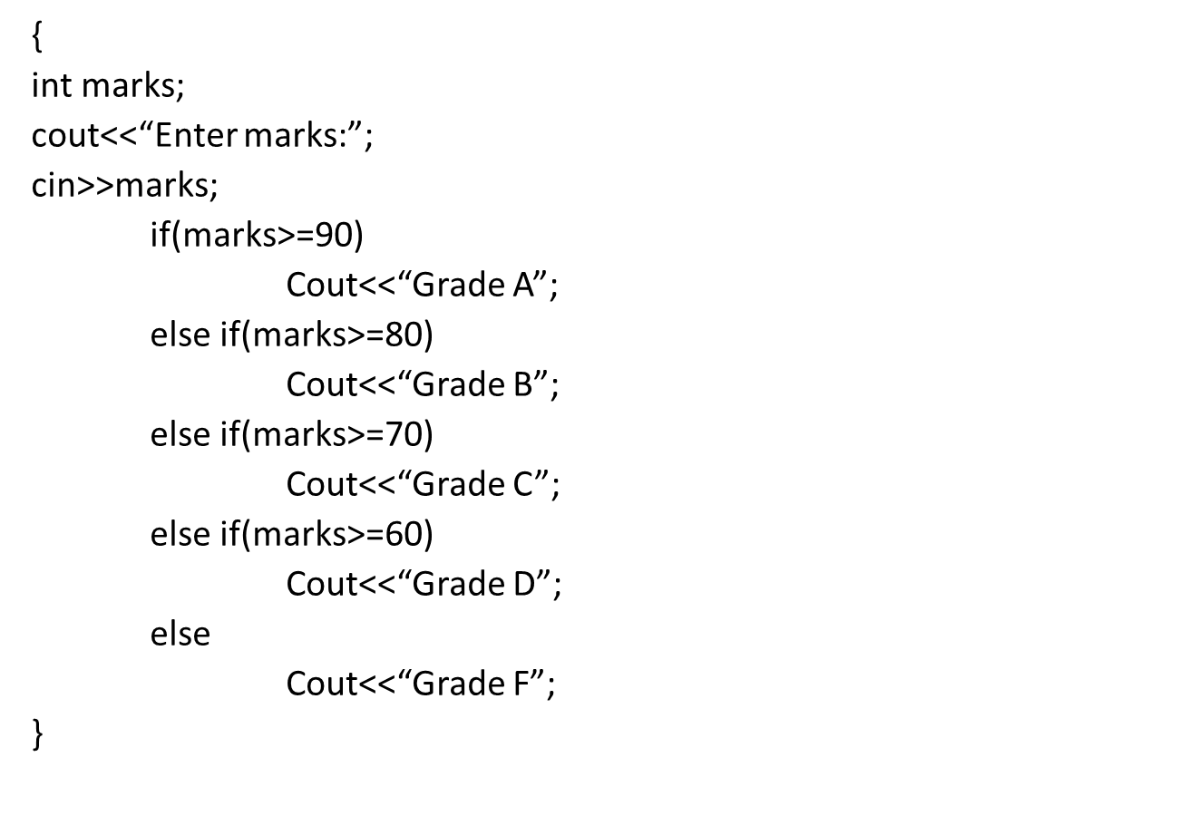
Example

Slide 41
Switch statement
switch provides a better alternative than if-else-if when the execution follows several branches depending on the value of an expression.
General form:
switch (expression) {
case value1: statement1; break;
case value2: statement2; break;
case value3: statement3; break;
…
default: statement;
}

Slide 42
Example
Write a program that inputs a character from the user and checks whether it is a vowel or consonant.

Slide 43
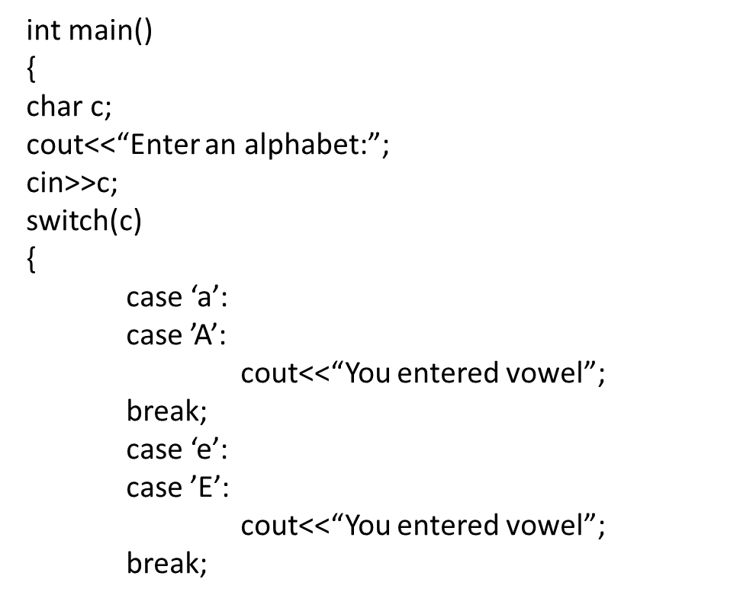
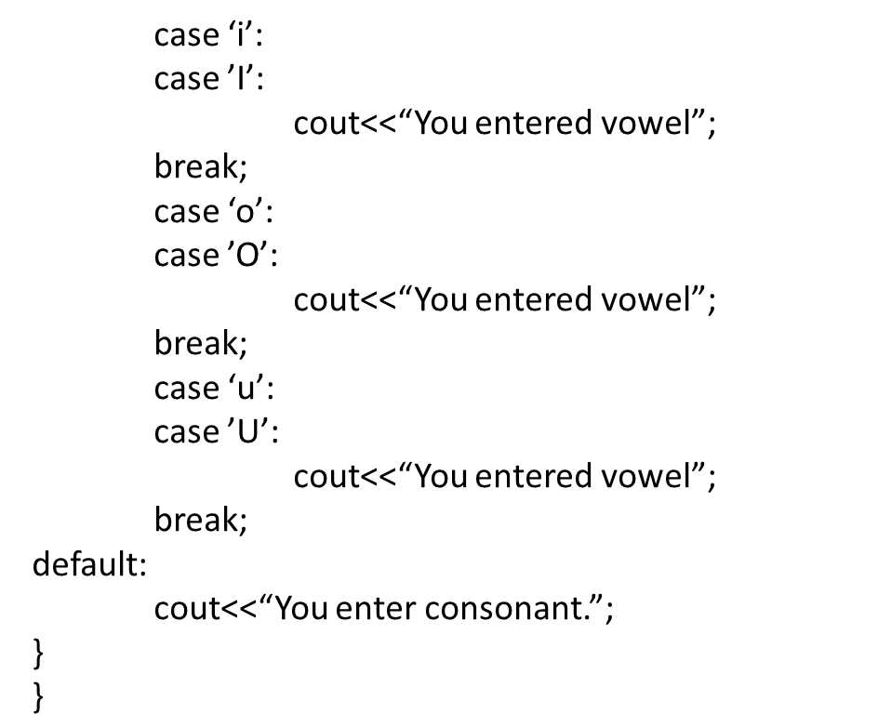
Example

Slide 44
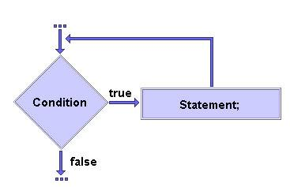
while
General form:
while (expression) statement
where expression must be of type boolean.
The component statement may be:
simple
while (expression) statement;
compound
while (expression) {
statement;
}

Slide 45
Example
Write a program that displays first five numbers and their sum using while loop.

Slide 46
Example
int main()
{
int c, sum;
c=1;
sum=0;
while(c<=5)
{
cout<<c<<endl;
sum = sum + c;
c=c+1;
}
cout<<“Sum is = ”<<sum;
}

Slide 47
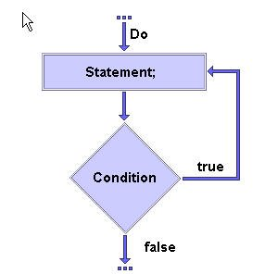
Do-while statement
If a component statement has to be executed at least once, the do-while statement is more appropriate than the while statement.
General form:
do statement
while (expression);
where expression must be of type boolean.

Slide 48
Example
Write a program that gets starting and ending point from the user and displays all odd numbers in the given range using do-while loop

Slide 49
Example
{
int c, s, e;
cout<<“Enter starting number:”;
cin>>s;
cout<<“Enter ending number:”;
cin>>e;
c = s;
do
{
if(c % 2 !=0)
cout<<c<<endl;
c = c + 1;
}
while(c<=e);
}

Slide 50
For statement
When iterating over a range of values, ‘for’ statement is more suitable to use than while or do-while.
General form:
for (initialization; termination; increment)
statement
where:
initialization statement is executed once before the first iteration
termination expression is evaluated before each iteration to determine when the loop should terminate
increment statement is executed after each iteration

Slide 51
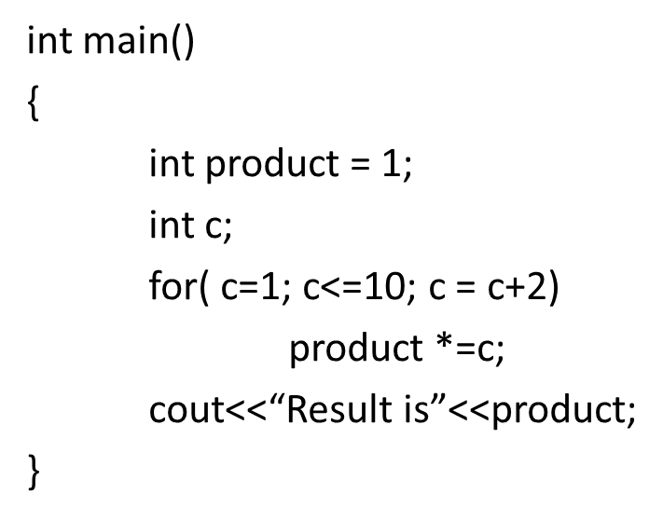
Example
Product of all odd numbers from 1 to 10

Slide 52
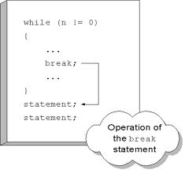
Break Statement
The break statement has three uses:
to terminate a case inside the switch statement
to exit an iterative statement
to transfer control to another statement
Other statements after the break are not executed.
The control directly moves outside the body and the statement that comes after the body is executed.

Slide 53
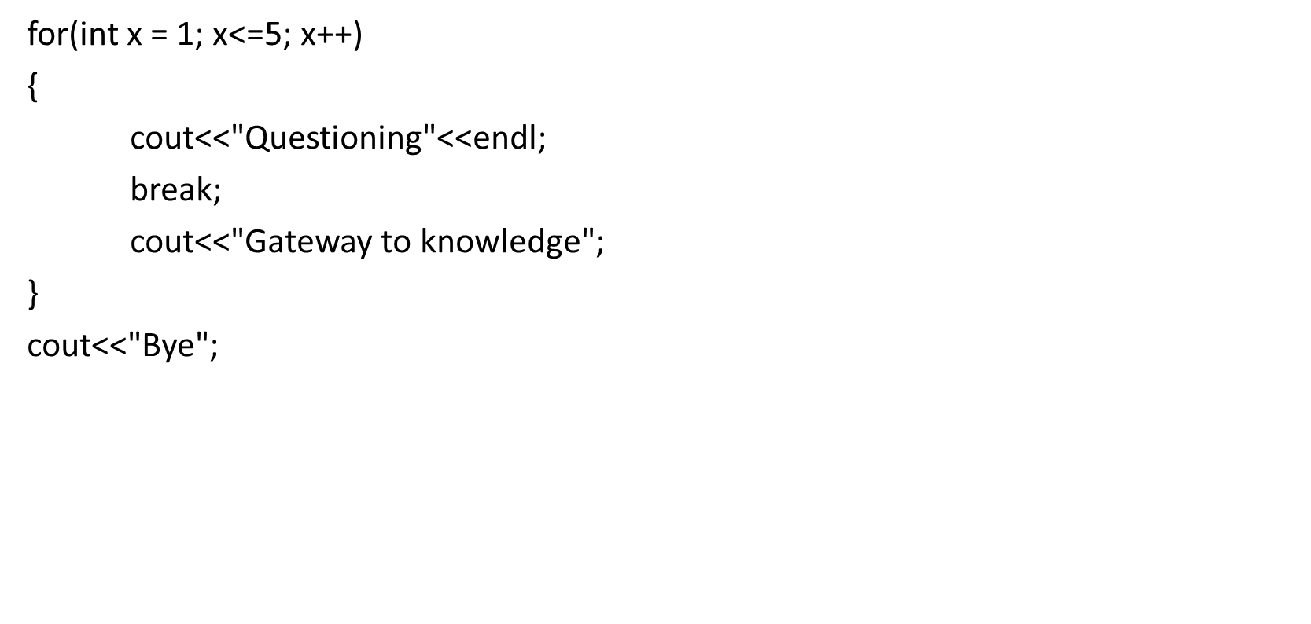

Slide 54

Return statement
The return statement is used to return from the current method: it causes program control to transfer back to the caller of the method.
The return statement returns the flow of the execution to the function from where it is called.
This statement does not mandatorily need any conditional statements. As soon as the statement is executed, the flow of the program stops immediately and returns the control from where it was called.
The return statement may or may not return anything for a void function, but for a non-void function, a return value must be returned.
Two forms:
return without value
return;
return with value
return expression;

Slide 55
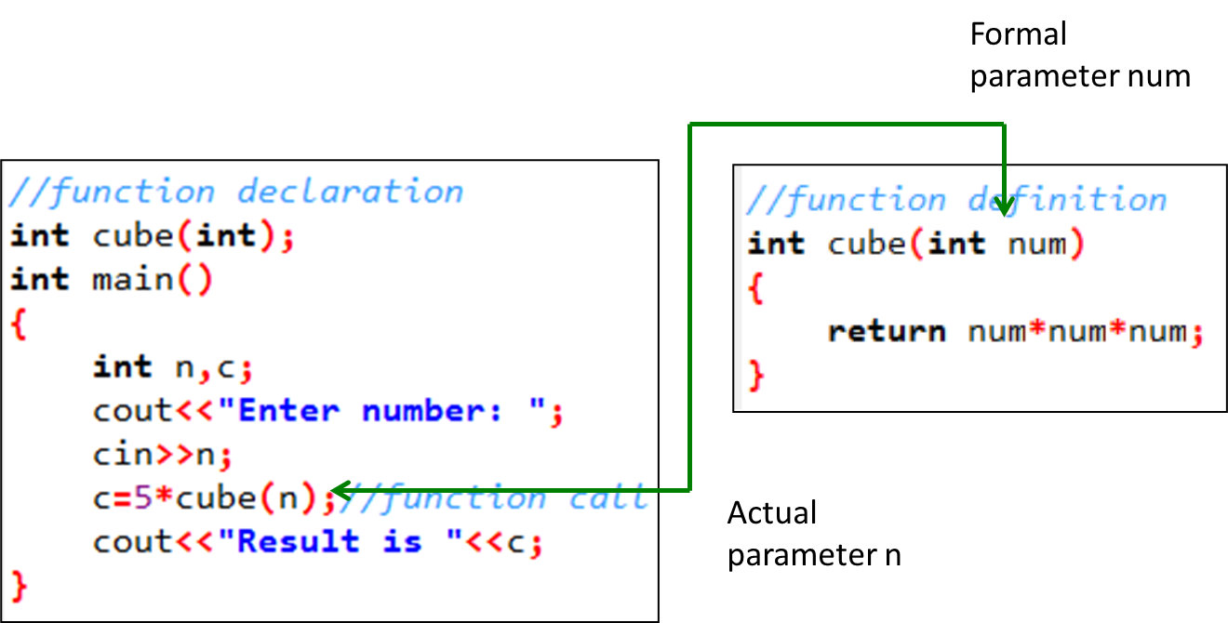
Example

Slide 56
Continue Statement
The break statement terminates the block of code, in particular it terminates the execution of an iterative statement.
The continue statement forces the early termination of the current iteration to begin immediately the next iteration.
When continue statement is used inside the body of the loop it shifts the control to the start of the loop body.
When this statement is executed in the loop body, the remaining statements of current iteration are not executed.
The control directly moves to the next iteration.

Slide 57
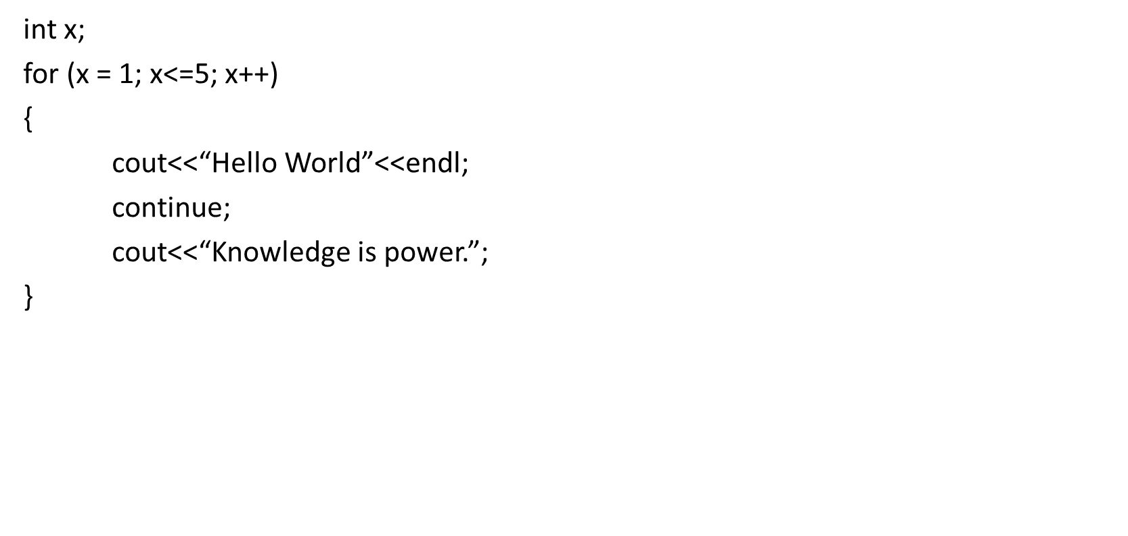

Slide 58
Questions?

